Slide 1
X-Ray Measurement Tracking Platform
Hospital for Special Surgery
Summer 2019 Project

Slide 2
Summary
Analyze of the needs
suggestions
Ideal solution
Context and main issue
possible outcomes

Slide 3
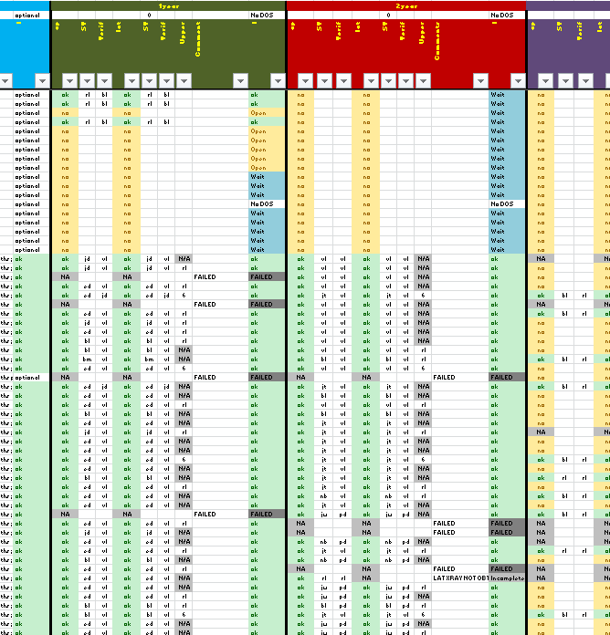
Context
Many sources of X-Rays : 23 Studies ongoing at the same time
X-Rays could be Surgical or Non-Surgical
Each patient has many X-Rays on different parts of the body
Different X-Rays are taken at different times :
PreOp
6 weeks
3m/6m
1year
Each X-Ray has to be checked multiple times for the measurment process
➔ Actual tracking tool : huge Excel completed manually, too complicated and not a long-term solution

Slide 4
Idea Create a tool that would
Centralize all information about each X-Ray :
Study
Surg/NonOp
Patient number
Time of X-Ray
Measurement Checklist
Have a user-friendly platform that will enable each user to know what still has to be done

Slide 5
Requirements expressed for the tool
Interface for user
(Need to be able to identify yourself ?)
Tracker
measurement to do
verification to do
Depending on user, verification does not show-up
Image comments and quality
Image with problem need to be tracked (add comment)
Generate report
Number of measurement performed between a specific period
Image due / missing
Per study, per site, per branch, per patient etc …
5. Update
Add more studies
Close some study (if needed)
6. Should be able to handle in a close future automatic info from other tool
Update for online FTP
Automatic measurement from Surgimap
Etc …

Slide 6

Requirements User interface
The user interface should :
Provide a connection to each user with an username and password
OR
Recognize the session from which the interface is opened and provide the relative authorizations
Associate to each users the X-Rays he/she measured and provide a list of ongoing studies with X-Rays that have to me measured

Slide 7

Requirements Tracker
For each X-Rays, the interface should :
Recognize the status of the X-Rays depending on file presence on the Local Drive → automatically found by the software
Adapt to each user by giving the authorization to validate the check at some level

Slide 8
Requirements Image Quality
For each X-Rays, the interface should :
Provide a way to evaluate the quality of the image → manually entered by the user
Suggestions :
Scale from 1 to 5
Three solution
No image
Image but bad quality
Exploitable content
Colors

Slide 9
Requirements Creating a New Patient
Informations needed per patient :
Study the patient is from
Site
Patient number
Date of Birth
Date of Surgery if Op

Slide 10
Centralizing and Organizing Possible sorting by :
Patient
Study
Quality of image

Slide 11

Data extracting
Number of tracking per month
Number of tracking per user
Number of patients
Number of Studies
Number of Surg/NonOp X-Rays
Number of X-Rays per time period

